Slide 1
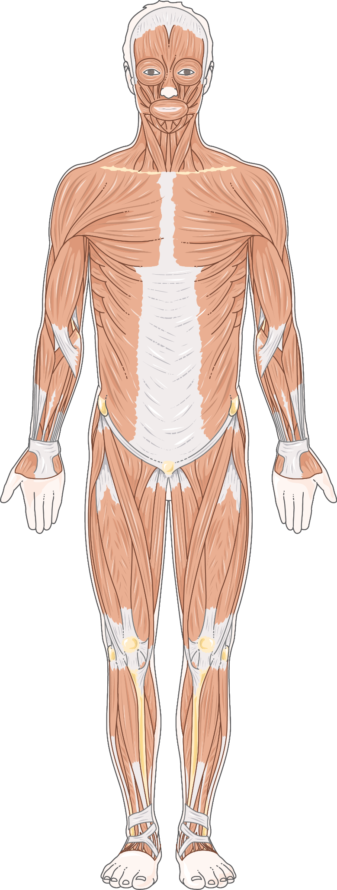
Training Intensity and Performance Enhancing Drugs:
Summary of what I will talk About:

Slide 2
HIGH INTENSITY TRAINING
Script for what I said:
High intensity training can be summarised with 2 categories HIIT (high intensity interval training) and Heavy weights low repetitions’ which is also is a highly time effective and efficient method of stimulating substantial muscle growth, as it involves one or a set of movements at maximum effort over a short period of time. The practical implication of the program allows for overweight individuals to quickly lose weight. [Boutcher, S.H. (2010)]. While Heavy weights on the other hand tend to have different affects depending on your initial muscle maturity, for example a well built physique is unlikely to see significant skeletal muscle hypertrophy form training as compared to a un built physique, this is due to the natural muscle capacity limitations due to muscle insertions, frame and hormone responses such as that of myostatin. Although this does not necessarily transfer over to strength gains, as the more a movement is preformed the more mind muscle connections can be formed as neural pathways interlinking the brain to the muscle become stronger leading to more muscle recruitment the more a muscle is used, as well as more efficient muscle connectivity chains being created allowing for greater strength to be achieved with prolonged exposure. to stimuli. [Lopez, P. et al. (2021)] As a direct result of this athletic performance can increase yearly without the necessary gain of additional muscle, the best method in modern use would result from greater time under tension whilst performing eccentric movements such as lowering weights form a bicep curl. This method of training allows for more easy time management, and less overall effort as compared to the HIIT and low intensity training as maximum effort is only used for a shorter duration in comparison to the overall length of the workout. [ Using eccentric training to increase muscle mass (2020)]
References for what I said:
Boutcher, S.H. (2010) High‐intensity intermittent exercise and Fat Loss. Edited by E. Doucet. Available at: https://onlinelibrary.wiley.com/doi/10.1155/2011/868305 (Accessed: 30 October 2024).
Lopez, P. et al. (2021) Resistance training load effects on muscle hypertrophy and strength gain: Systematic review and network meta-analysis, Medicine and science in sports and exercise. Available at: https://pmc.ncbi.nlm.nih.gov/articles/PMC8126497/#sec18 (Accessed: 30 October 2024).
Using eccentric training to increase muscle mass (2020) Eccentric training for muscle mass. Available at: https://www.issaonline.com/blog/post/using-eccentric-training-to-increase-muscle-mass (Accessed: 30 October 2024).

Slide 3
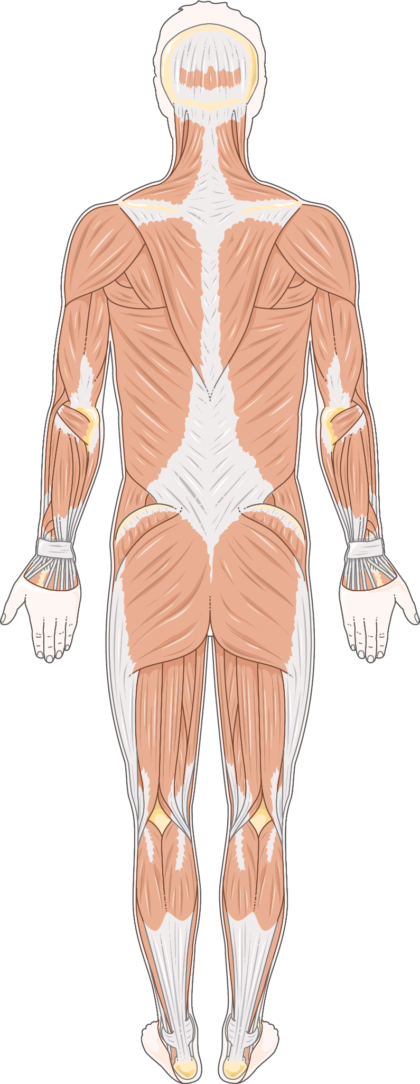
LOW INTENSITY TRAINING
Script for what I said:
Low intensity endurance training leads to the development of local skeletal muscles, for example increased mitochondrial biogenesis / capillary density. This therefore allows for a greater transport of oxygen to regenerate ATP, releasing energy, preventing the build-up of lactic acids and causing muscle fatigue in aerobic performance. [ Joyner, M.J. and Coyle, E.F. (2008)]. On a test of sedentary obese males they with a BMI of over 30, they deduced that low intensity training (e.g long distance running, swimming etc) over a longer duration of time closer to the FAT max (the maximum amount of fat burned within an hour) performed the best in reducing their weights and thus increasing the cardiovascular outputs; which in turn improved there endurance.[ Khanfir, M.A. et al. (2022)].However the only negative with this method would be the time commitment as the aforementioned study required 3 to 4 days or training ranging from an hour onwards until maximum cardiovascular threshold was reached
References for what I said:
Joyner, M.J. and Coyle, E.F. (2008) Endurance exercise performance: The physiology of champions - joyner - 2008 - the journal of physiology - wiley online library, Endurance exercise performance: the physiology of champions. Available at: https://physoc.onlinelibrary.wiley.com/doi/10.1113/jphysiol.2007.143834 (Accessed: 30 October 2024).
Khanfir, M.A. et al. (2022) Effects of Different Low-Intensity Exercise Types on Duration, Energy Expenditure and Perceived Exertion in Obese Individuals, International journal of environmental research and public health. Available at: https://pmc.ncbi.nlm.nih.gov/articles/PMC9032643/#sec5-ijerph-19-04893 (Accessed:`30 october)

Slide 4
Using PEDS to enhance Performance
Script for what I said:
Many athletes tend to use PEDS (performance enhancing drugs) to increase their muscle output as well as increase training efficiencies have been shown to bring
overall increase in strength, endurance and hypertrophy when paired with either low intensity or High intensity training. For example, the use of HGH (human growth
hormone) to be used by athletes to increase collagen synthesis in their tendons in order to increase their size allowing for their bodies to hold more skeletal muscle
which in turn allows for a greater performance in sports and other activities. [ Doessing, S. et al. (2010)]. In total there an insurmountable number of steroids and other
supplements made but the general gist is that they suppress a certain hormone in order to increase another. This then allows the body to obtain inhuman levels of
strength for example if the hormone myostatin in reduced by using glucocorticoids. A notable fact during this experiment was that participants gained tendon strength
enough though they did not train , the steroid (HGH) increase there base line muscle allowing them to be stronger without the added effort of training.
References for what I said:
Doessing, S. et al. (2010) Growth hormone stimulates the collagen synthesis in human tendon and skeletal muscle without affecting myofibrillar protein synthesis, The Journal of physiology. Available at:https://pmc.ncbi.nlm.nih.gov/articles/PMC2821728/#:~:text=PMID%3A%2019933753
-,Growth%20hormone%20stimulates%20the%20collagen%20synthesis%20in%20huma %20tendon%20and,without%20affecting%20myofibrillar%20protein%20synthesis (Accessed:31 October 2024).

